Slide 2

Introduction to
Data Science
(IT4142E)

Slide 3
Contents
Lecture 1: Overview of Data Science
Lecture 2: Data crawling and preprocessing
Lecture 3: Data cleaning and integration
Lecture 4: Exploratory data analysis
Lecture 5: Data visualization
Lecture 6: Multivariate data visualization
Lecture 7: Machine learning
Lecture 8: Big data analysis
Lecture 9: Capstone Project guidance
Lecture 10+11: Text, image, graph analysis
Lecture 12: Evaluation of analysis results

Slide 4
Outline
Internet crawlers
Scrapy framework

Slide 5
Introduction

Slide 6
Recall: insight-driven DS methodology
Data collection (scraping)
Data cleaning Data pre-processing
Data integrating
Data exploration
&
visualization
Analysis, hypothesis testing, & ML
Insight & Policy Decision

Slide 7
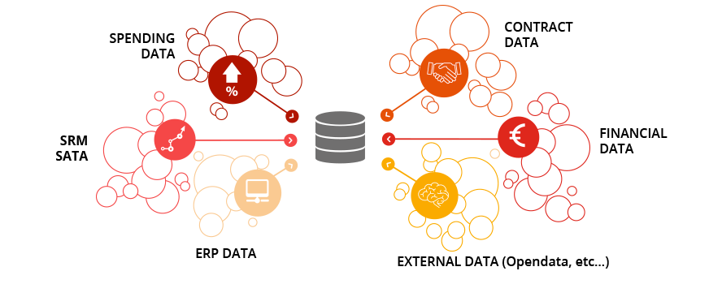
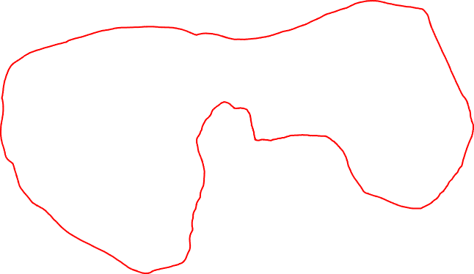
What is Data Scraping?
First (crucial) step of data science
Gathering all relevant data for future data analysis
Both internal and external data
INTERNAL DATA (inside the enterprise/organization)

Slide 8
How to access the data?
Everything depends on the type of source!
Internal data:
Databases, data warehouses
Flat files
Structured (Excel, log files..)
Unstructured
Readable by humans
Text
Screen display
Reports
External data
API (SOAP or REST): https://youtu.be/bPNfu0IZhoE
Flat files (same as internal data)

Slide 9
Examples of open-source data
Global Health Facts (www.globalhealthfacts.org/)—Health-related data about countries in the world
UNdata (http://data.un.org/)—Aggregator of world data from a variety of sources
World Health Organization(www.who.int/research/en/)—Again, a variety ofhealth-related datasets such as mortality and life expectancy
OECD Statistics (http://stats.oecd.org/)—Major source for economic indicators
World Bank (http://data.worldbank.org/)—Data for hundreds of indicators and developer-friendly
Census Bureau (www.census.gov/)—Find extensive demographics here.
Data.gov (http://data.gov/)—Catalog for data supplied by government organizations. Still relatively new, but has a lot of sources.
Data.gov.uk (http://data.gov.uk/)—The Data.gov equivalent for the United Kingdom.
data.gouv.fr (http://data.gouv.fr) — The French equivalent
DataSF (http://datasf.org/)—Data specific to SanFrancisco.
NYC DataMine (http://nyc.gov/data/)—Just like the above, but for New York.
ParisData (http://opendata.paris.fr) — Paris
OpenData La Rochelle (https://opendata.larochelle.fr/) — La Rochelle

Slide 10
Accessing the data via APIs
Numerous services are available online via http
Data transfer is made following a protocol ruling exchange formats
Such exchanges are well-structured, well-documented, easy to parse (a.k.a. analyze) and minimize ambiguities
Such exchange formats are usually difficult to read for a human
Protocols used • SOAP: structured using XML • REST: often structured using JSON
Example: parkings with available spots in La Rochelle:
https://opendata.larochelle.fr/dataset/stationnement-parking-tarifs-synthetiques/

Slide 11
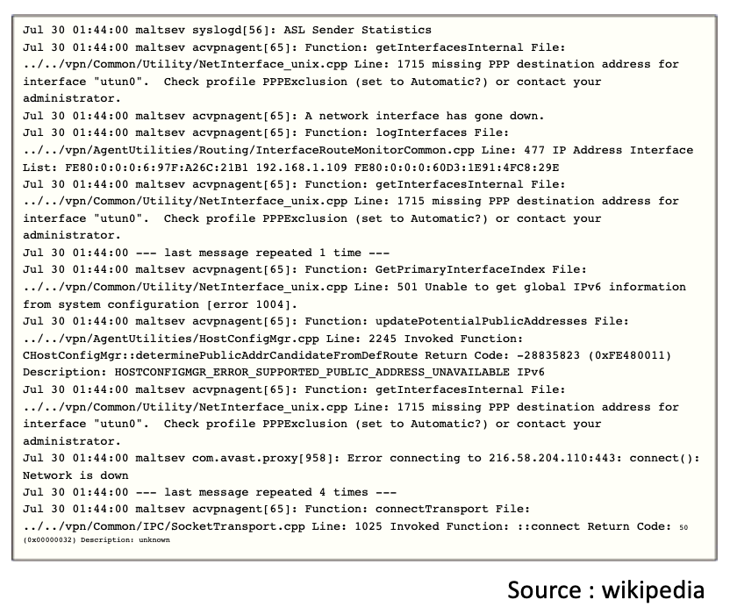
Accessing the data via log files
Log files contain a sequential history of events in a process
API, network activity…
Log entries are generally time-stamped and in chronological order
Enable to analyse the process’s activity and its interactions with its environment

Slide 12
Accessing the data via log files
Most often used standard format: syslog
Date of emission
Name of the device
Process that triggered emission
Priority Level
Message contents
Message category
Seriousness level
ELK is certainly the most used open-source platform for logging (including log visualization)

Slide 13
Definitions
Data scraping, screen scraping, report mining, web scraping

Slide 14
Accessing the data via data scraping
Data scraping is used when the system to request does not have interface nor API to access the data
Data scraping is a technique for extracting data from a document published in order to be read by humans
Often, web-pages from which we want to gather information
But also, any other kind of information formated to be displayed on a screen / text terminal

Slide 15
Some limits of data scraping
The operator that publishes these documents might not like data scraping, because it might lead to
The system’s overload
A loss of revenues generated by the ads on the webpage
A loss of control over the documents provided
Intellectual property issues
Data scraping is usually reserved to cases where there is no alternative

Slide 16
What is screen mining?
Consists in extracting the text from the displaying screen of a device
Usual screen scraping methods use bitmap screenshots and OCR
In some cases, a program is used to simulate the user’s behavior and contol the GUI
Hence, a sequence of screens can be automatically captured and fed to a database

Slide 17
What is report mining?
Consists in extracting the text from the reports written and formatted to be readable by humans (PDF, text, etc.)
Simple and quick way to access data without the need for an API
Examples of softwares: Tabula, import in Tableau

Slide 18
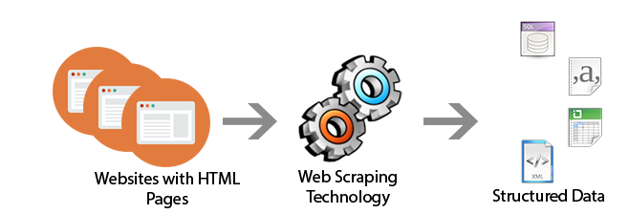
What is web scraping?
Web pages are text files using a markup-based language (HTML and XHTML) that often contain relevant data
However, most web pages are conceived for a final (human) user, not for their automatic use
That is why web scraping tools were conceived
In order to defend themselves from web scraper, some sites use defense methods (limiting the number of requests / IP, CAPTCHA…)

Slide 19
Web crawler

Slide 20

Web crawler
A Spider, also known as a robot or a crawler, is actually a program that follows, or ”crawls” links throughout the Internet, grabbing content from sites and adding it to the database.
Crawler
Spider
Robot
Web agent

Slide 21
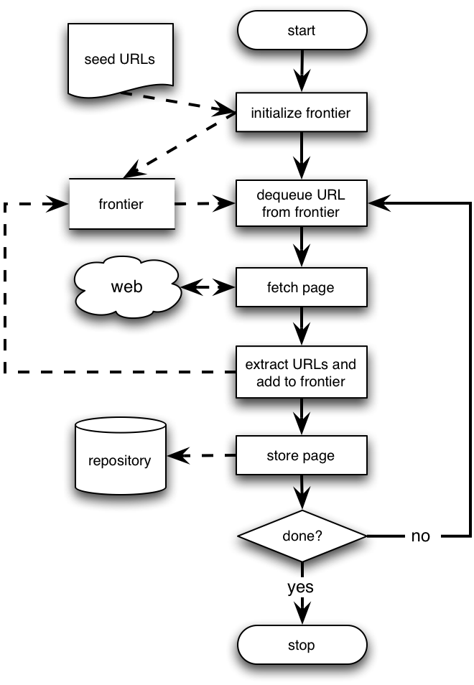
Basic crawling operation
Begin with known “seed” URLs
Fetch and parse them
Extract URLs they point to
Place the extracted URLs on a queue
Fetch each URL on the frontier (queue) and repeat
URLs crawled
and parsed
Unseen Web
Seed
pages
URLs frontier
Web

Slide 22
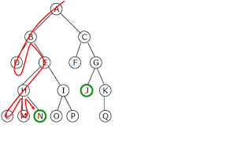
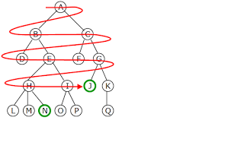
Crawling policy
Behavior of a Web crawler is the outcome of a combination of policies
Selection policy which states the pages to download
Re-visit policy which states when to check for changes to the pages
Politeness policy that states how to avoid overloading website
Parallelization policy that states how to coordinate distributed web crawlers

Slide 23
Web crawling challenges
The Internet is huge
Googlebot are distributed
Filtering interested/non-interested/malicious pages
Spam pages
Spider traps – pages that are dynamically generated
Content freshness
Crawlers should be catchup with new, up-to-date contents
Content deduplication
Site mirrors and duplicate pages

Slide 24
Trading-off exploitation vs. exploration
Exploitation
the crawling of pages where the expected value can be predicted with a high confidence
Exploration
the search for new sources of relevant pages

Slide 25
Politeness
Explicit
Specified by webmasters on which parts of the site can be crawled (robots.txt)
Implicit
Avoid hitting any site too often to consume too much webserver resource

Slide 26
Robots.txt
Sec. 20.2.1
Protocol for giving spiders “robots” limited access to a website, originally from 1994
www.robotstxt.org/wc/norobots.html
Website announces its request on what can(not) be crawled
For a server, create a file /robots.txt
This file specifies access restrictions
Example
User-agent: *
Disallow: /yoursite/temp/
User-agent: searchengine
Disallow:

Slide 27
Web-scraping
Some principles

Slide 28
Web scraping
Web scraping constists in extracting relevant information from a web page in order to re-use this data in another framework and / or under another form

Slide 29
Difference between web scraping and web crawling
The difference between web scraping and crawling lies in its final goal
Web crawling creates a copy of existing data
Web scraping extracts specific data for analysis
The final goal of data scraping is data science
Hence, it converts un-structured data available in the web into more structured data, that can be analysed
Example:
What Google, Yahoo or Bing does is web crawling
Their indexing is based on web crawling

Slide 30
Use-cases
Private use: online services; comparing information from different websites (e.g. price comparison of flight tickets / fares for the same itinerary but with different companies
Academic research: the web is a huge multi-domain data source that can provide researchers with a huge volume of data (for machine learning for instance, see Chapter 5)
Marketing analysis: the traces we leave on the web are getting more and more numerous and allow companies to grasp our preferences, routines, etc. This data is used for marketing, and personalizing ads

Slide 31
Extraction modes
Semi-automatic extraction: using a software or an app to suck / clean selected contents from one or several web pages
Only the contents that is relevant to the user
This is what we will do during exercises / homework
Automatic extraction : using a software or an app to create a corpus of web-pages linked with each other
All contents is extracted
The software / app emulates a web browser that visits pages and is able to follow all hyperlinks to generate the corpus of all web-pages

Slide 32
Extraction techniques
In order to extract information from web pages, the most usual methods use XPath
XPath is a W3C standard to find elements in a XML document
W3C is the organization that rules on the web standards
XPath uses the hierarchical structure of nodes (and attributes) of an XML document, and therefore requires a precise document structure
HTML documents partly respect a hierarchical format with XML tags
Parsers need to be flexible

Slide 33
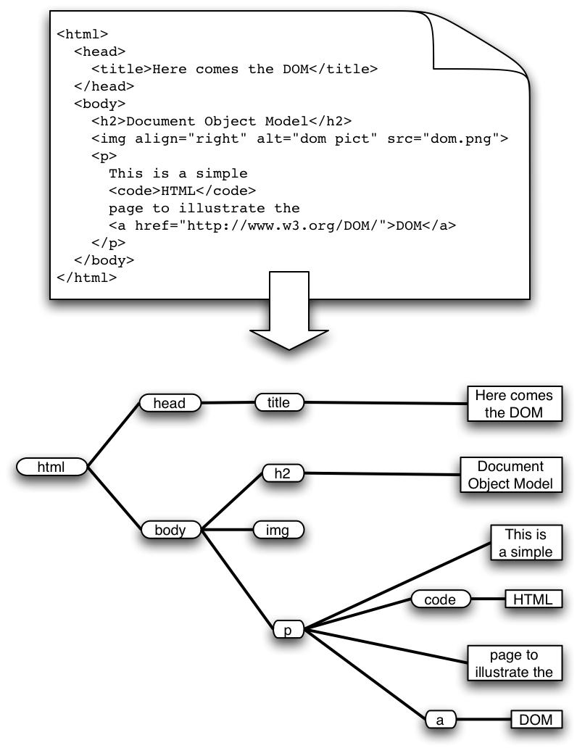
HTML code structure
HTML has the structure of a Document Object Model (DOM) tree
DOM tree varies from page to page, even for the same catalog
Due to dynamic contents, dynamic ads, etc.

Slide 34
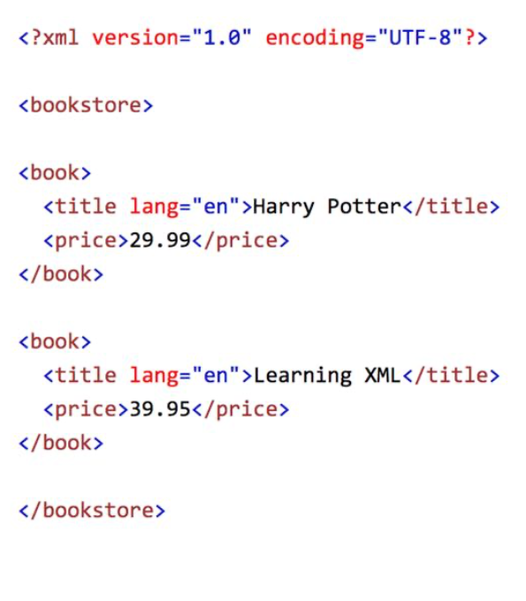
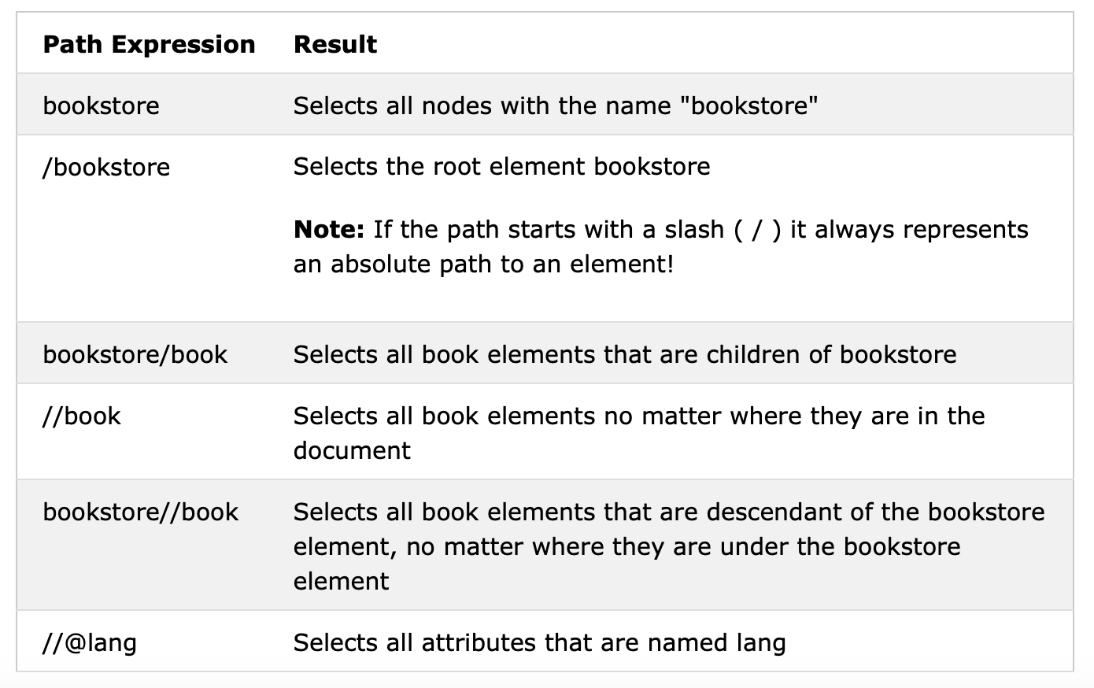
Xpath: example
Practice it yourself on https://www.w3schools.com/xml/xpath_examples.asp

Slide 35
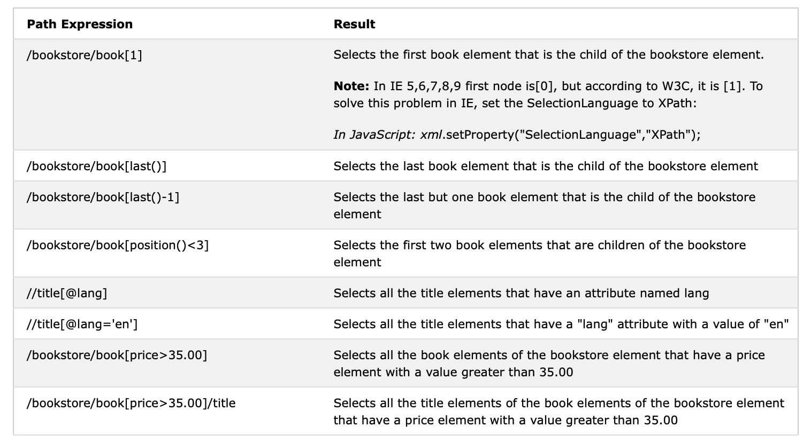
Xpath: example

Slide 36
Technical limitations
Inconsistent / cahotic organization of the information
Relevant information might be formatted in a different way within different websites, or even within one single website
Evolutions in the information structure
Some data scraping programs are meant to be run on a routine, over time, to suck all freshly added info
As the website structure might evolve with time, the criteria that were settled initially to select relevant information might become obsolete
This problem arises most often for websites that use Content Management Systems (e.g. Wordpress) that allow to change for the graphical theme
As changes in the graphical theme often imply changes in the document structure

Slide 37
Technical limitations
Access restrictions
Some website contents are exclusively available for authentified users
There are tools that can emulate authentication procedure, one has to possess a registered login/password, and provide it to the extraction tool
Dynamically generated contents
Some pages don’t load all content from the first request
Instead, they dynamically load the contents according to the browser’s actions
These actions triggering queries on the website’s database, e.g. mySQL
Even though some tools can emulate this type of interactions, most often, the analysis is made on the HTML contents generated from the first request

Slide 38
Technical limitations
As stated before, the website publisher might not like data scraping, because it might lead to
The system’s overload
A loss of revenues generated by the ads on the webpage
A loss of control over the documents provided
Intellectual property issues
Website administrators might use some of the following tools to prevent « non-human » traffic
Time limitations for each request
Limitation in the number of hits / second for instance
A hit is the fact of going from one page to another, from the same domain
Reason for using this type of limitations is that humans usually take much longer to go from one page to another than a data scraper

Slide 39
Technical limitations
Website administrators might use some of the following tools to prevent « non-human » traffic
Time limitations for each request
IP address-based Denial of Service (DoS)
Automatically triggered when a website receives too many requests from one IP address
DoS is often used in case of cyber-attacks
Bandwidth limitations
Verification that the user is human
e.g. CAPTCHA, etc.

Slide 40
Ethical / legal aspects
Legal aspects regarding web-content reproductions are
Unclear in most countries
Note the European regulation « General Data Protection Regulation » (GDPR)
Differ largely from one country to another
Is it OK to cite contents from another site, even if one provides the reference?
Tough question!
On one hand, intellectual property is respected because credit is given to the original author
On the other hand, the original author looses traffic on his/her own website, which might cause a loss of revenue (ads, etc.)

Slide 41
Ethical / legal aspects
A good practice is to inform the website’s administrator that you have the intention to use their website’s contents
No formal request is legally required, but the advantage of asking is twofold
You might obtain an agreement, thus avoiding some of the previously cited technical limitations
The administrator might give you info or means to access the webpage contents, e.g. via APIs
In exchange, the administrator might ask you to add his/her URL(s) on your own website (if any) to enhance their ranking by search engines
Win-win situation!

Slide 42
Practice
Web-scraping with web-scraper and Scrapy

Slide 43
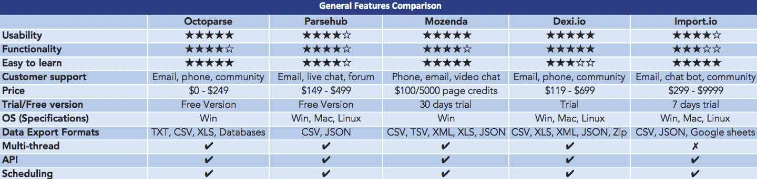
Web scraping tools
There are numerous web scraping tools, with different interface types:
Programming
Software libraries: Scrapy, Beautifulsoup (Python), PhantomJS
Cloud: ScrapingHub, Dexi.io...
Stand-alone: ParseHub, OctoParse...
Web-browser plugins:
Data Scraper - Easy Web Scraping, Instant Data Scraper, Web Scraper

Slide 44
Why using Web-Scraper and Scrapy?
Web-Scraper
Simple to install and to use
Easy to understand
Free for non-cloud usage
Scrapy
Example of an effective Python library
Open-source web scraping framework
More refined than Web-Scraper

Slide 45
Practice
Web-scraper

Slide 46
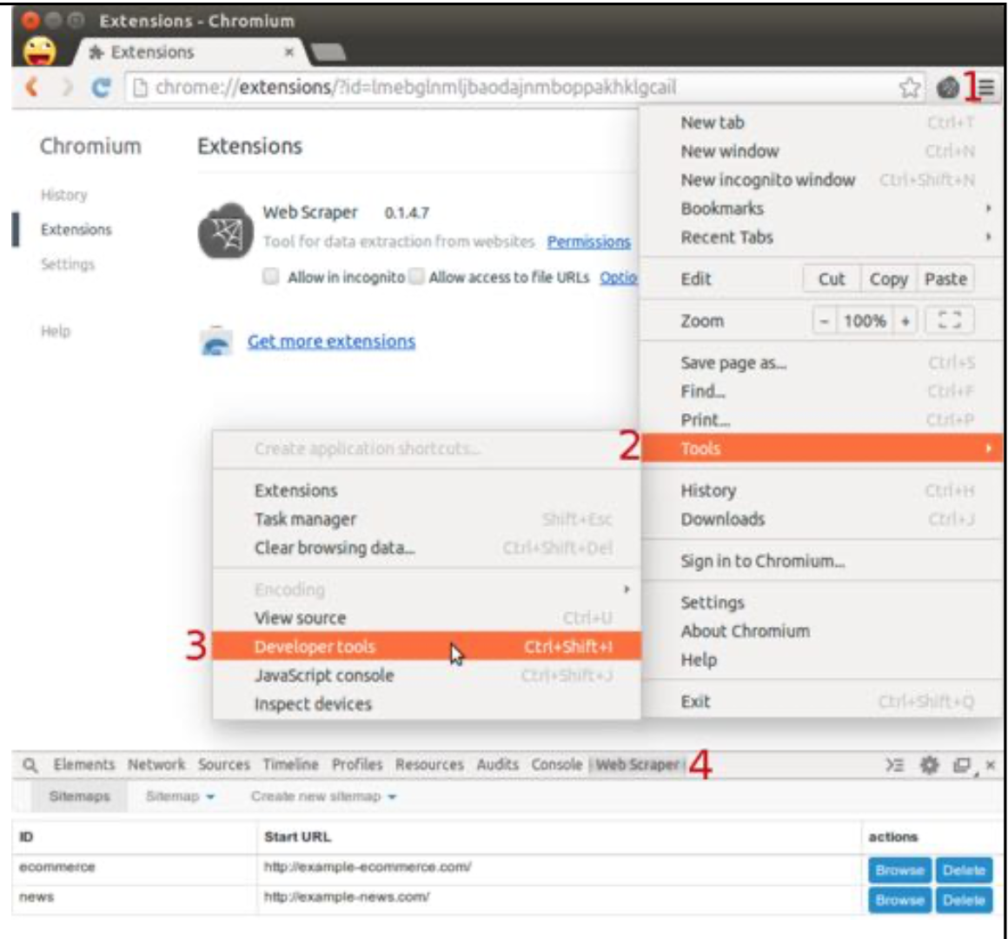
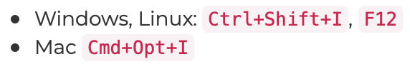
Opening web-scraper
Web Scraper is integrated into Chrome Developer tools
You can install the extension from Chrome store or Firefox browser Add-ons.
Keyboard shortcuts to open Developer tools:
After opening Developer tools, open Web Scraper tab

Slide 47
Web-scraper: sitemap
To start with, the user must specify the URL from which information should be extracted
The URL can be parameterized so as to scrap multiple pages, e.g. by specifying the page numbers
Example
http://example.com/page/[0-20:10] corresponds the the URLs:
http://example.com/page/0
http://example.com/page/10
http://example.com/page/20

Slide 48
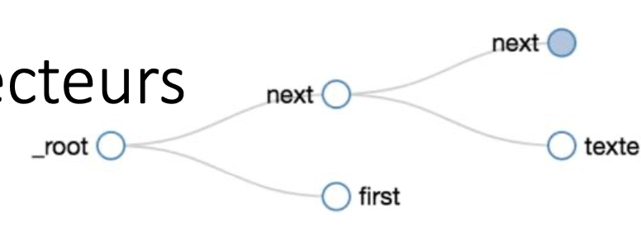
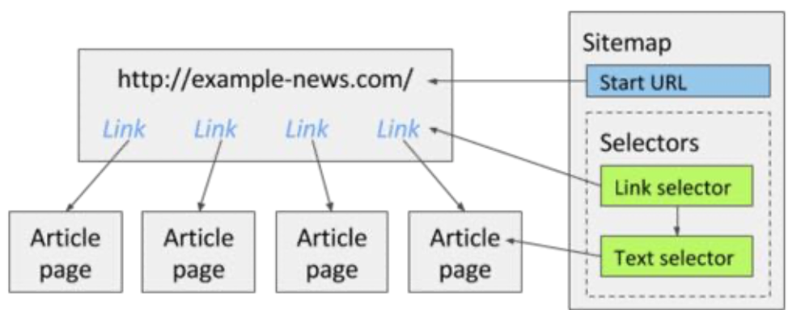
Web-scraper: selectors hierarchy
Web-Scraper uses a hiararchy of selectors
Data extraction selectors
Link selectors for site navigation
Element selectors
A selector references an element in the XPath hierarchy
From any element, one can select its descendants
Information lie in the tree leaves
Text
Image
Table

Slide 49
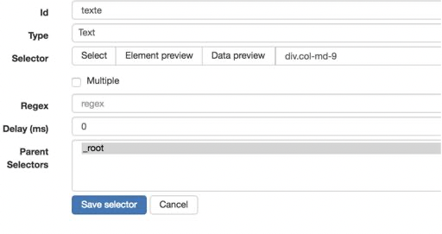
Web-scraper: text selector
Text selector is the most simple selector
Used for text selection
Extract text from the selected element and from all its child elements.
HTML will be stripped and only text will be returned (ignor <script> and <style> tags). New line <br> tags will be replaced with newline characters.
You can additionally apply a regular expression to resulting data.
Element Preview
Highlighting the selected text
Data Preview
Result data
The right part contains the Xpath selector

Slide 50
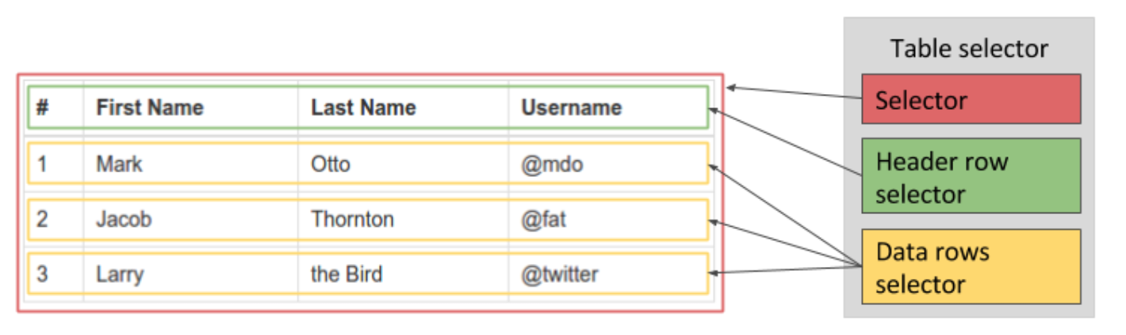
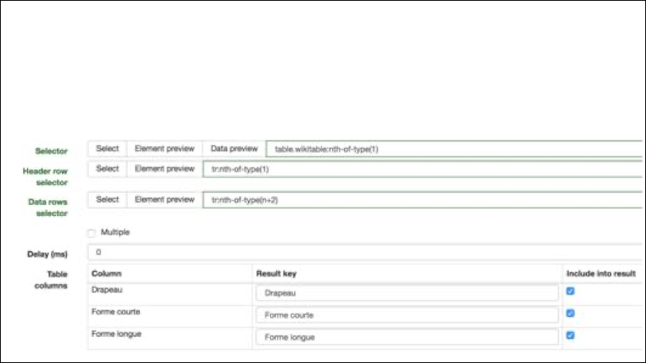
Web-scraper: table selector
Composite selector
Check « Multiple » to select all rows

Slide 51
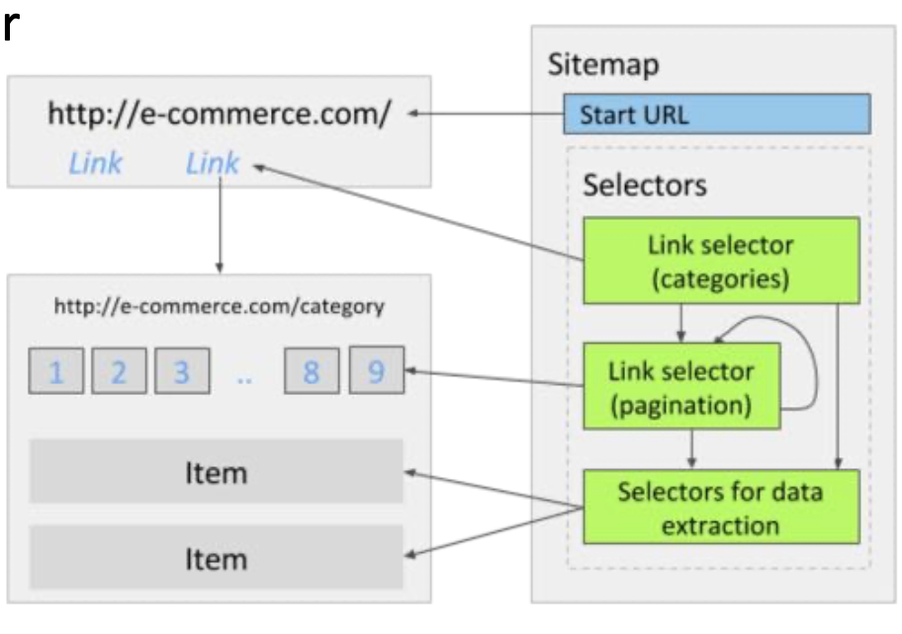
Web-scraper: link selector
Link selector is used for link selection and website navigation.
If you use Link selector without any child selectors then it will extract the link and the href attribute of the link
If you add child selectors to Link selector then these child selectors will be used in the page that this link was leading to
Link selectors can
be recursive

Slide 52
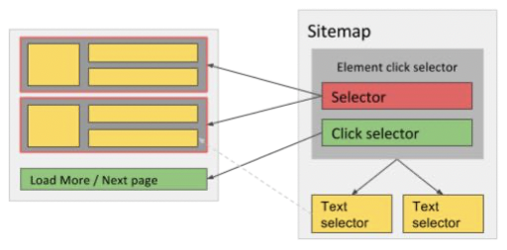
Web-scraper: click selector
Click selectors are used when it is necessary to emulate a click

Slide 53
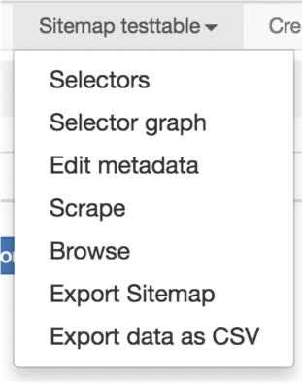
Web-scraper: data export
To be able to export data, one needs to
Scrape the page(s)
A popup opens up on the selected URL
Selectors are triggered according to the graph
Data is fetched and exported
Web Scraper browser extension supports data export in CSV format
Web Scraper Cloud supports data export in CSV, XLSX and JSON formats

Slide 54
Web-scraper: demo
https://youtu.be/n7fob_XVsbY

Slide 55
References
https://www.webscraper.io/tutorials
https://www.webscraper.io/documentation

Slide 56
Practice
Scrapy

Slide 57
Intro
Whereas Web Scraper is a web-browser extension enabling semi-automatic extraction…
… Scrapy is a more complete open-source Python library
Scrapy can handle by itself « annoying stuff », such as
Throttling
Concurrency
XML sitemaps
Filtering duplicated URLs
Retry on Error

Slide 58
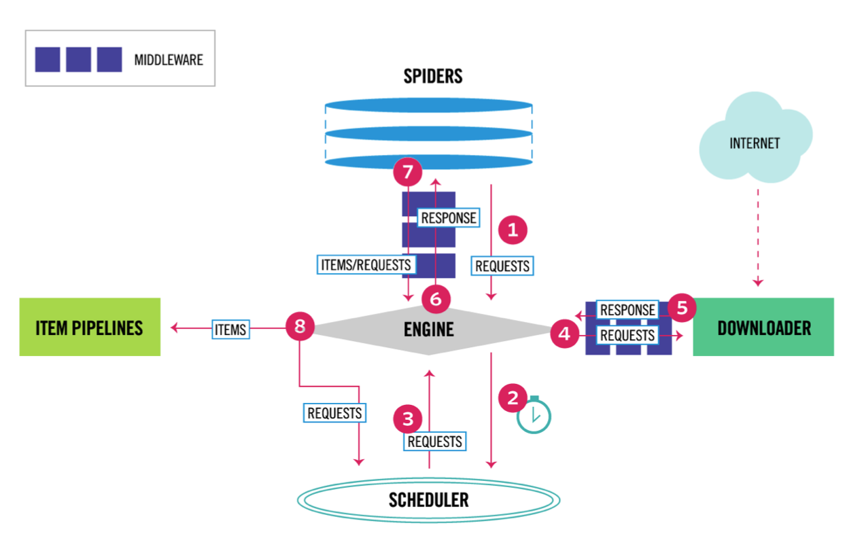
Scrapy components

Slide 59
Scrapy components
Scrapy Engine
controlling the data flow between all components
Scheduler
receives requests from the engine and enqueues them for feeding them later
Downloader
Fetching web pages and feeding them to the engine
Spiders
parse responses and extract items or additional requests to follow
Item pipeline
processing the items once they have been extracted by the spiders
Downloader middlewares
Process requests when they pass from the Engine to the Downloader and vice-versa
Spider middlewares
specific hooks that sit between the Engine and the Spiders
process spider input (responses) and output (items and requests)

Slide 60
Exercises / homework
XPath
Learn it by yourself on https://www.w3schools.com/xml/xpath_examples.asp
WebScraper tutorial
https://www.webscraper.io/tutorials
Scrapy
https://doc.scrapy.org/en/latest/intro/tutorial.html
Define your own data structures
Write spider
Leverage Built-in Xpath and CSS selectors to extract desired data
Built-in Json, csv, xml output
Interactive shell console
https://doc.scrapy.org/en/latest/topics/media-pipeline.html
Downloading and processing files and images
« Web Scraping in Python using Scrapy _ Codementor »: PDF in the Google Teams

Slide 61
The PageRank Citation Ranking: Bring Order to the web
(Adapted from Fei Li presentation on PageRank)

Slide 62
Motivation and Introduction
New challenges for information retrieval on the World Wide Web.
Huge number of web pages: 150 million by1998, 1000 billion by 2008
Diversity of web pages: different topics, different quality, etc.
What is PageRank?
A method for rating the importance of web pages objectively and mechanically using the link structure of the web.

Slide 63
The History of PageRank
PageRank was developed by Larry Page (hence the name Page-Rank) and Sergey Brin.
It is first as part of a research project about a new kind of search engine. That project started in 1995 and led to a functional prototype in 1998.
Shortly after, Page and Brin founded Google.
Since then
There are large numbers of Search Engine Optimization (SEO).
SEO use different trick methods to make a web page more important under the rating of PageRank.

Slide 64
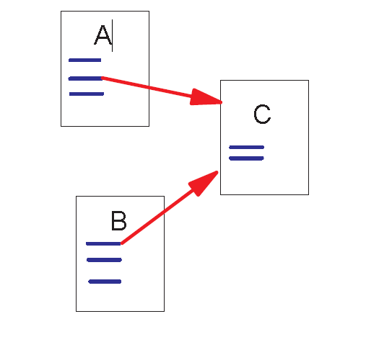
Link Structure of the Web
150 million web pages → 1.7 billion links
Backlinks and Forward links:
A and B are C’s backlinks
C is A and B’s forward link
Intuitively, a webpage is important if it has a lot of backlinks.
What if a webpage has only one link off www.cnn.com?

Slide 65
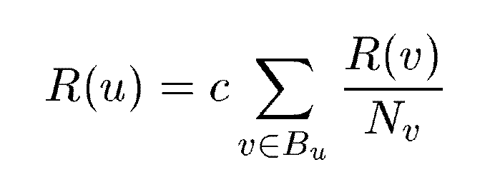
A Simple Version of PageRank
u: a web page
Bu: the set of u’s backlinks
Nv: the number of forward links of page v
c: the normalization factor to make
||R||_{L1} = 1 (||R||_{L1}= |R₁ + … + R_{n}|)

Slide 66
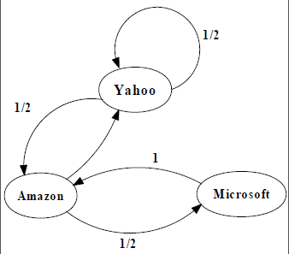
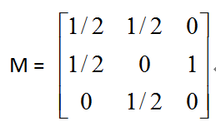
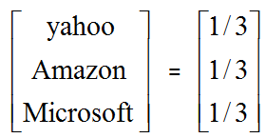
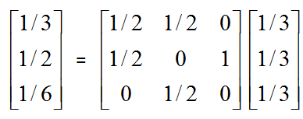
An example of Simplified PageRank
PageRank Calculation: first iteration

Slide 67
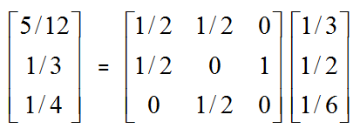
An example of Simplified PageRank
PageRank Calculation: second iteration

Slide 68
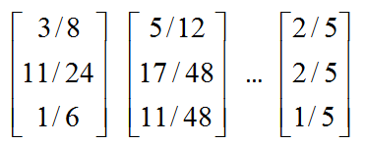
An example of Simplified PageRank
Convergence after some iterations

Slide 69
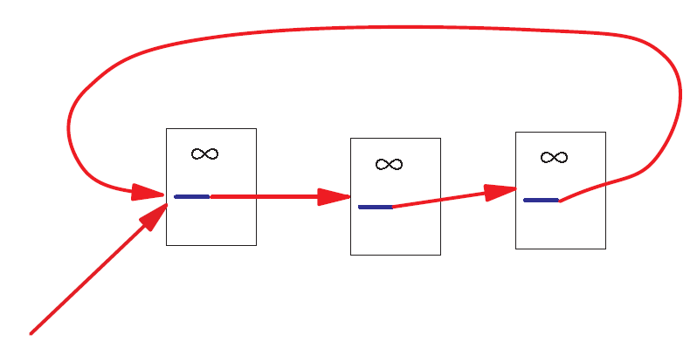
A Problem with Simplified PageRank
A loop:
During each iteration, the loop accumulates rank but never distributes rank to other pages!

Slide 70
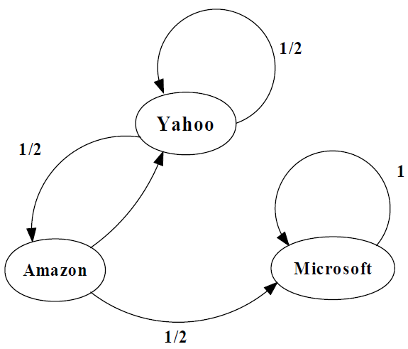
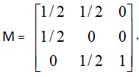
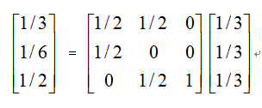
An example of the Problem

Slide 71
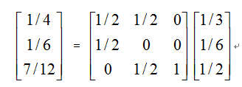
An example of the Problem

Slide 72
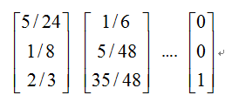
An example of the Problem

Slide 73
Random Walks in Graphs
The Random Surfer Model
The simplified model: the standing probability distribution of a random walk on the graph of the web. simply keeps clicking successive links at random
The Modified Model
The modified model: the “random surfer” simply keeps clicking successive links at random, but periodically “gets bored” and jumps to a random page based on the distribution of E

Slide 74
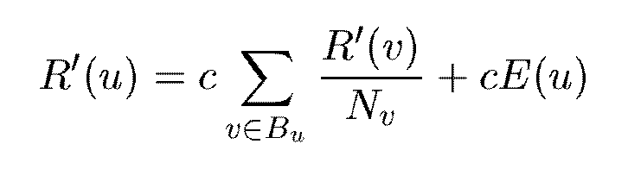
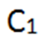
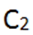
Modified Version of PageRank
E(u): a distribution of ranks of web pages that “users” jump to
when they “gets bored” after successive links at random.
For uniform random jump: E(i) = 1/n

Slide 75
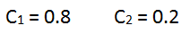
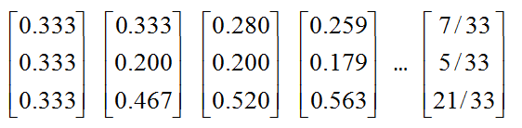
An example of Modified PageRank

Slide 76
Dangling Links
Links that point to any page with no outgoing links
Most are pages that have not been downloaded yet
Affect the model since it is not clear where their weight should be distributed
Do not affect the ranking of any other page directly
Can be simply removed before pagerank calculation and added back afterwards

Slide 77
PageRank Implementation
Convert each URL into a unique integer and store each hyperlink in a database using the integer IDs to identify pages
Sort the link structure by ID
Remove all the dangling links from the database
Make an initial assignment of ranks and start iteration
Choosing a good initial assignment can speed up the pagerank
Adding the dangling links back.

Slide 78
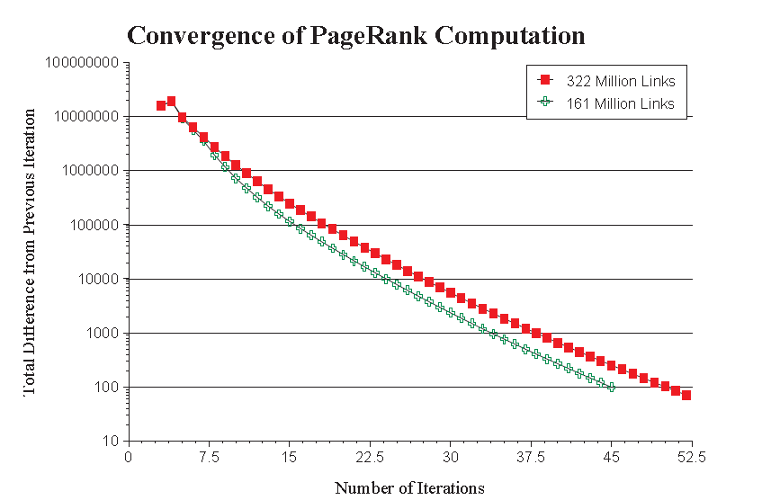
Convergence Property
PR (322 Million Links): 52 iterations
PR (161 Million Links): 45 iterations
Scaling factor is roughly linear in logn

Slide 79
Searching with PageRank
Two search engines:
Title-based search engine
Full text search engine
Title-based search engine
Searches only the “Titles”
Finds all the web pages whose titles contain all the query words
Sorts the results by PageRank
Very simple and cheap to implement
Title match ensures high precision, and PageRank ensures high quality
Full text search engine
Called Google
Examines all the words in every stored document and also performs PageRank (Rank Merging)
More precise but more complicated

Slide 80
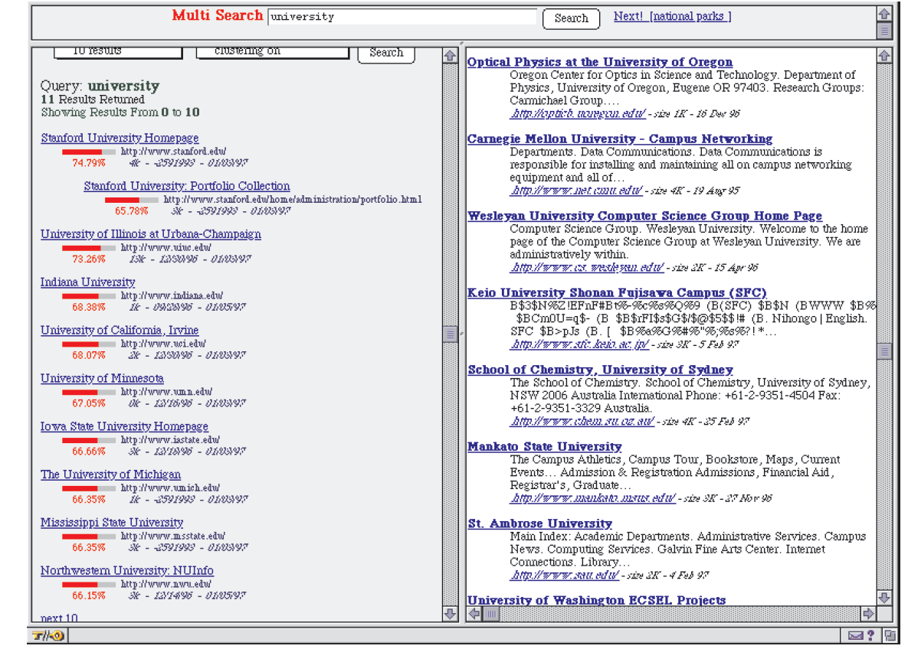
Searching with PageRank

Slide 81
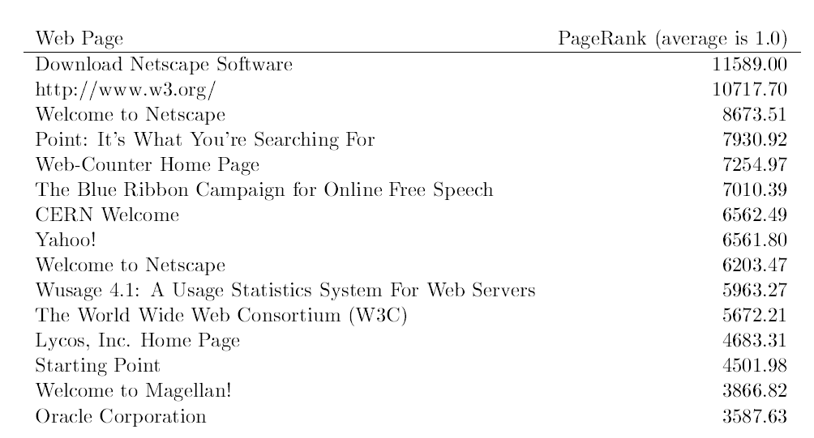
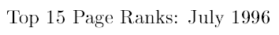
Searching with PageRank

Slide 82
Personalized PageRank
Important component of PageRank calculation is E
A vector over the web pages (used as source of rank)
Powerful parameter to adjust the page ranks
E vector corresponds to the distribution of web pages that a random surfer periodically jumps to

Slide 83
PageRank vs. Web Traffic
Some highly accessed web pages have low page rank possibly because
People do not want to link to these pages from their own web pages (the example in their paper is pornographic sites…)
Some important backlinks are omitted
use usage data as a start vector for PageRank.

Slide 84
Conclusion
PageRank is a global ranking of all web pages based on their locations in the web graph structure
PageRank uses information which is external to the web pages – backlinks
Backlinks from important pages are more significant than backlinks from average pages
The structure of the web graph is very useful for information retrieval tasks.

